Slide 1
Travelling Salesman Problem Using Genetic Algorithm
Rupak Dehingia
Manab Kalyan Saha

Slide 2
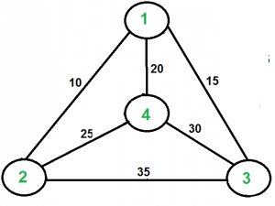
Travelling Salesman Problem
Given a set of cities and distances between every pair of cities, the problem is to find the shortest possible route that visits every city exactly once and returns to the starting point.
The set of cities are {1, 2, 3, 4} and the edges are shown in the figure on the right side.
A TSP tour in the graph is 1-2-4-3-1. The cost of the tour is 10+25+30+15 which is 80. The problem is a famous NP-hard problem. There is no polynomial-time known solution for this problem.
Here we will be solving this problem using a genetic algorithm in python. It is a basic implementation of genetic algorithm.

Slide 3
Genetic Algorithm
Genetic Algorithms(GAs) are adaptive heuristic search algorithms that belong to the larger part of evolutionary algorithms. Genetic algorithms are based on the ideas of natural selection and genetics. These are intelligent exploitation of random search provided with historical data to direct the search into the region of better performance in solution space.
They are commonly used to generate high-quality solutions for optimization problems and search problems.

Slide 4
Genetic Algorithm (contd.)
Genetic algorithms simulate the process of natural selection which means those species who can adapt to changes in their environment are able to survive and reproduce and go to next generation. In simple words, they simulate “survival of the fittest” among individual of consecutive generation for solving a problem. Each generation consist of a population of individuals and each individual represents a point in search space and possible solution.
Each individual is represented as a string of character/integer/float/bits. This string is analogous to the Chromosome.

Slide 5
Formulation of GA
Creating initial population.
Calculating fitness.
Selecting the best genes.
Crossing over.
Mutating to introduce variations.

Slide 6
Fitness Score
A Fitness Score is given to each individual which shows the ability of an individual to “compete”. The individual having optimal fitness score (or near optimal) are sought.
The individuals with better fitness scores are selected who mate and produce better offspring by combining chromosomes of parents.
Each new generation has on average more “better genes” than the individual (solution) of previous generations. Thus each new generations have better “partial solutions” than previous generations.

Slide 7
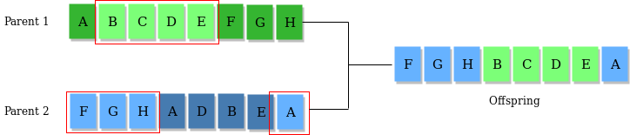
Selection and Crossover
Selection Operator: The idea is to give preference to the individuals with good fitness scores and allow them to pass there genes to successive generations.
Crossover Operator: This represents mating between individuals. Two individuals are selected using selection operator and crossover sites are chosen randomly. Then the genes at these crossover sites are exchanged thus creating a completely new individual (offspring).

Slide 8
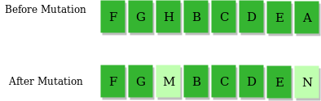
Mutation
Mutation Operator: The key idea is to insert random genes in offspring to maintain the diversity in the population to avoid premature convergence.

Slide 9
Summary of GA
Randomly initialize population
Determine fitness of population
Until convergence repeat:
a) Select parents from population
b) Crossover and generate new population
c) Perform mutation on new population
d) Calculate fitness for new population

Slide 10
Moving to… Implementation

Slide 11
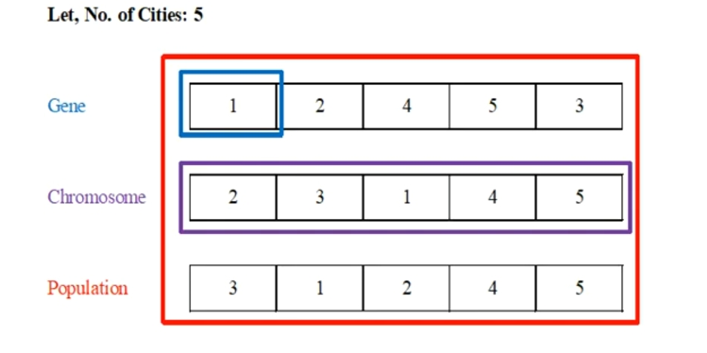
Approach
In the following implementation, cities are taken as genes, path generated using these cities is called a chromosome, while population is the set of all the chromosomes.
A fitness score which is equal to the path length of all the cities mentioned, is used to target a population.

Slide 12
Step 1: Initialization
POPULATION_SIZE = 20
CITIES_SIZE = 20
TOUR_SIZE = 21
NUM_EXECUTION = 9999
population = []
x = []
y = []
tour = [[0 for x in range(TOUR_SIZE)] for y in range(TOUR_SIZE)]
dCidade = [[0 for x in range(POPULATION_SIZE)] for y in range(POPULATION_SIZE)]
distances = [0 for x in range(POPULATION_SIZE)]
parentsOne = None
parentsTwo = None
costByExecution = []

Slide 13
Step 2: Initial Population Generation
"""
Generates the first population
"""
def generateFirstPopulation():
# For each position, generates a new possible path
for _ in range(1, POPULATION_SIZE + 1):
generatePossiblePath()

Slide 14
Step 3: Fitness Calculation
"""
Generate the identity matrix (dCidade) based on
the x and y arrays and then call the
calculateDistances() method to generate the array with the sum of each path to user later in the cycle
process
"""
def fitnessFunction():
for i in range(len(population)):
for j in range(len(population)):
dCidade[i][j] = round(math.sqrt(((x[i] - x[j])**2) + ((y[i] - y[j])**2)), 4)
return calculateDistances()

Slide 15
Step 4: Selection Operator
"""
Performs the roulette function, generating two
arrays with half parents each,which will be used later to do the cycle process
"""
def rouletteFunction(sorted_x):
global parentsOne
global parentsTwo
arr = []
rouletteArr = []
for i in range(10):
arr.append(sorted_x[i][0])
for j in range(len(arr)):
for _ in range(10 - j):
rouletteArr.append(arr[j])
parentsOne = createParents(rouletteArr)
parentsTwo = createParents(rouletteArr)

Slide 16
Step 5: Crossover Operator
for i in range(5):
parentOneAux = parentsOne[i]
parentTwoAux = parentsTwo[i]
usedIndexes = []
randomIndexInsideCromossomus = random.randint(0, POPULATION_SIZE - 1)
usedIndexes.append(randomIndexInsideCromossomus)
childOne = copy.deepcopy(population[parentOneAux])
childTwo = copy.deepcopy(population[parentTwoAux])
valAuxOne = childOne[randomIndexInsideCromossomus]
valAuxTwo = childTwo[randomIndexInsideCromossomus]
childOne[randomIndexInsideCromossomus] = valAuxTwo
childTwo[randomIndexInsideCromossomus] = valAuxOne

Slide 17
Step 6: Mutation Operator
"""
makes the swap between 2 cities in the path
"""
def mutate(matrix):
for i in range(0, len(matrix)):
for _ in range(0, len(matrix[i])):
ranNum = random.randint(1, 100)
if ranNum >= 1 and ranNum <= 5:
indexOne = random.randint(0, 19)
indexTwo = random.randint(0, 19)
auxOne = matrix[i][indexOne]
auxTwo = matrix[i][indexTwo]
matrix[i][indexOne] = auxTwo
matrix[i][indexTwo] = auxOne

Slide 18
Step 7: Repeat generations
Finally, we have one generation of routes. Repeat it until the solution converges.
This completes the genetic algorithm implementation of the Travelling Salesman Problem.

Slide 19
Summary
We tried to approach towards a solution of Travelling Salesman Problem using Genetic Algorithm.
The genetic algorithm produces optimal solution from the initial population stage to successive population stages.
It approaches the problem using the process of natural selection and survival of the fittest. The one with the best path cost is considered for successive generation.
After nth generations, the evaluation process is completed and the most fittest one is considered as the optimal solution for the travelling salesman problem.

Slide 20
Thank You

